Slide 2
Representing Attitude
There are several ways to represent the rotation between two reference frames
Direction Cosines
Euler Angles
Quaternions (aka Euler Parameters)
and more
They all have their strengths and weaknesses

Slide 3
Strengths and Weaknesses of Attitude Representations
Representation | Strengths | Weaknesses | Best Used For
Direction Cosines | Work well with vectors Easy to catenate rotations Moderately intuitive (dot products) No singularities | 9 params for 3 DOF | Transforming Vectors
Quaternions | Efficient (4 params for 3 DOF) No singularities | Not intuitive | Propagating Equations of Motion
Euler Angles | Intuitive 3 params for 3DOF | Singularities 12 Variants | Input, Output Gimballed Joints

Slide 4
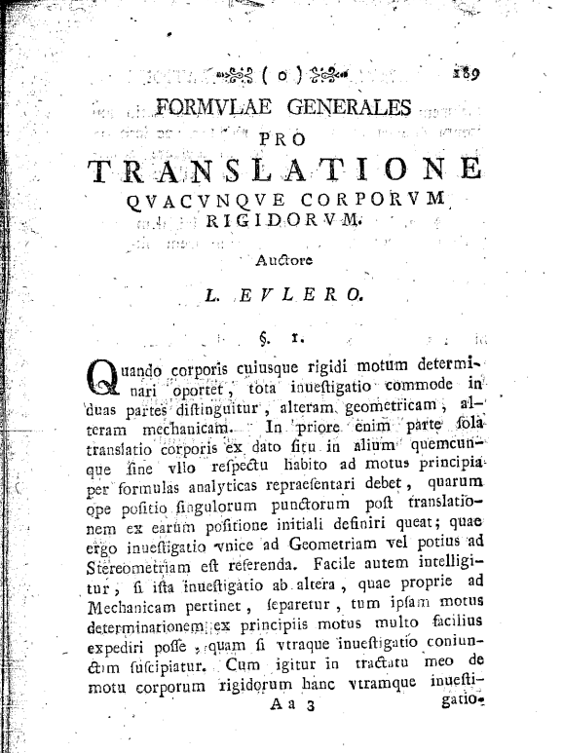
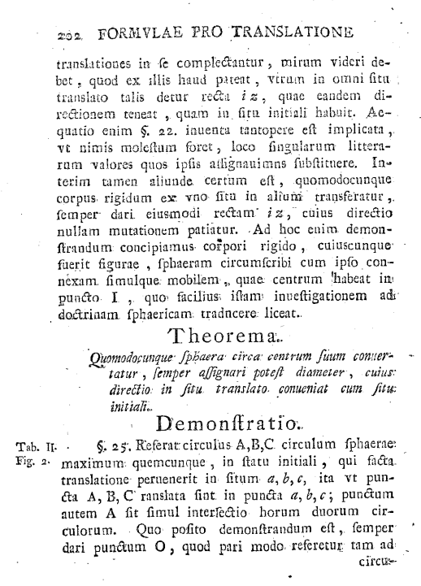
Euler’s Rotation Theorem (1776)

Slide 5


Euler’s Rotation Theorem
Theorema. Quomodocunque sphaera circa centrum suum conuertatur, semper assignari potest diameter, cuius directio in situ translato conueniat cum situ initiali.
n
θ

Slide 6
Euler’s Rotation Theorem
When a sphere is moved around its centre it is always possible to find a diameter whose direction in the displaced position is the same as in the initial position.

Slide 7
Direction Cosine Matrix (DCM)

Slide 8
Quaternions

Slide 9
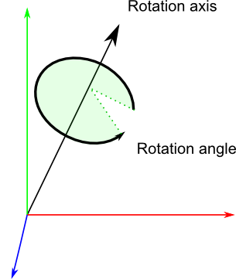
What a quaternion looks like

Slide 10
DCM’s & Quaternions

Slide 11
Matlab Interlude

Slide 12
Properties of Rotations

Slide 13


Notation for Quaternions, DCMs
The rotation from frame A to frame B may be described by the direction cosine matrix
Given the components of a vector in A, its components in B may be found by the multiplication
In C, we write the DCM as CBA to preserve order of superscripts, eg
Quaternions are another way to describe rotations. We use a parallel notation:
These and similar conventions promote concise, unambiguous code
$${}_{}^{B}{C_{ij}^{A}}={\overset{ˆ}{b}}_{i}⋅{\overset{ˆ}{a}}_{j}$$
$${}_{}^{B}v={}_{}^{B}{C_{}^{A}}{}_{}^{A}v$$
MxV(CBA,va,vb)
QxV(qba,va,vb)

Slide 14
References
http://www.opengl-tutorial.org/intermediate-tutorials/tutorial-17-quaternions/
https://en.wikipedia.org/wiki/Euler%27s_rotation_theorem

